Slide 1
Implementation of artificial intelligence and Electronic health in any threatening epidemic in Egypt
Dr l Asmaa Rashad Ali Al- Sayed
Lecturer in Microbiology, Faculty of Medicine for girls
Al-Azhar University

Slide 2
Introduction
The inevitable, but unpredictable, appearance of new infectious diseases has been recognized for millennia, well before the discovery of causative infectious agents.

Slide 3
Introduction (Con..)
Despite extraordinary advances in development of countermeasures (diagnostics, therapeutics, and vaccines), the ease of world travel and increased global interdependence have added layers of complexity to containing these infectious diseases that affect not only the health but the economic stability of societies.

Slide 4
Introduction (Con..)
There is an urgent and pressing demand for integration of new managing healthcare strategies and policies. Electronic health solutions have been identified as promising pillars to tackle pandemic challenges. According to the Organisation for Economic Co-operation and Development (OECD), telemedicine is being used to deliver healthcare in a wide range of specialties, for numerous conditions and through varied means.

Slide 5
Introduction (Con..)
E-Health is regarded as a fundamental resource for care nowadays, to the point that a growing number of scientific publications devoted to improve not only healthcare activities and epidemic control, but also patient adherence to treatment and healthy instruction, patient education, and even the monitoring of mental health outcomes such as stress and emotions.

Slide 6
Current approach
Access barriers,
Uncontrolled prices and costs,
Unacceptable quality,
Widespread disparities and inequities,
Marginalization of public health.
Underdeveloped Public health infrastructure
Inequitable access to health care services
Vaccines unavailability.

Slide 7
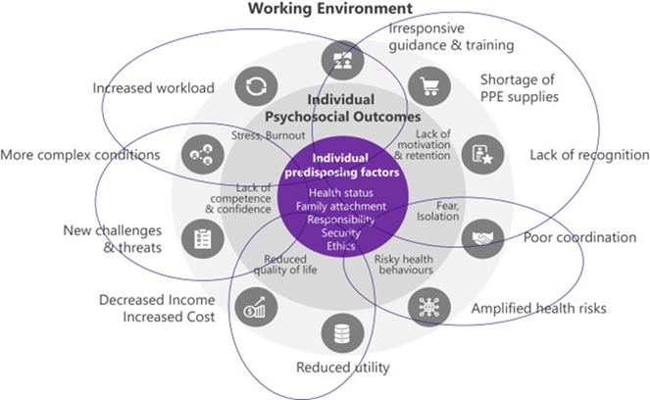
Current approach (Con..)
It is clear that many health care facilities were ill-equipped and unprepared to manage the influx of patients and had inadequate medical and epidemiological training to properly address patient care.

Slide 8
Current approach (Con..)
The pandemic continues to expose major weaknesses with the existing global health care system. Furthermore, the very week recording and tracing systems are associated with the catastrophic impact of that disaster.

Slide 9
Targeted approach

Slide 10
Objectives
This curriculum is aiming to:
Create an electronic health care system to trace the source of infection in health care facilities in Egypt.
Modify a strategic plan to attenuate the impending outbreak.
Design electronic tools to record vaccination states of population, and its shortage
Support the tool for rapid design of new vaccines on indication.

Slide 11
Strategies

Slide 12
Strategies
Step one: Create good risk communication system

Slide 13
Strategies
Step tow :Design trusted websites to spread guidelines and trusted statistical information to defiance misperceptions

Slide 14
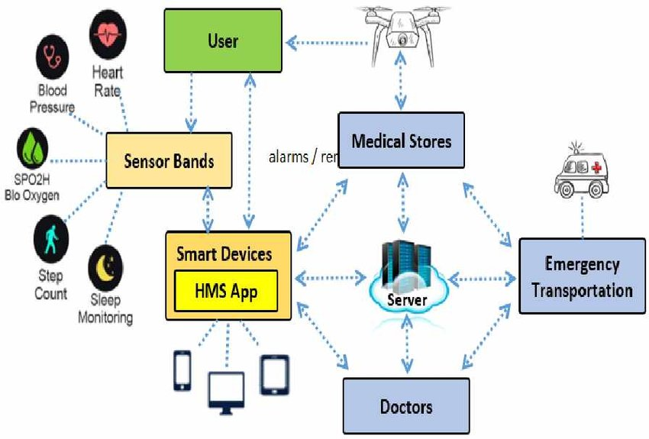
Strategies
Step three: Design Health Monitoring System Using Smart Phones and Wearable Sensor to allow patients to receive care from home.

Slide 15
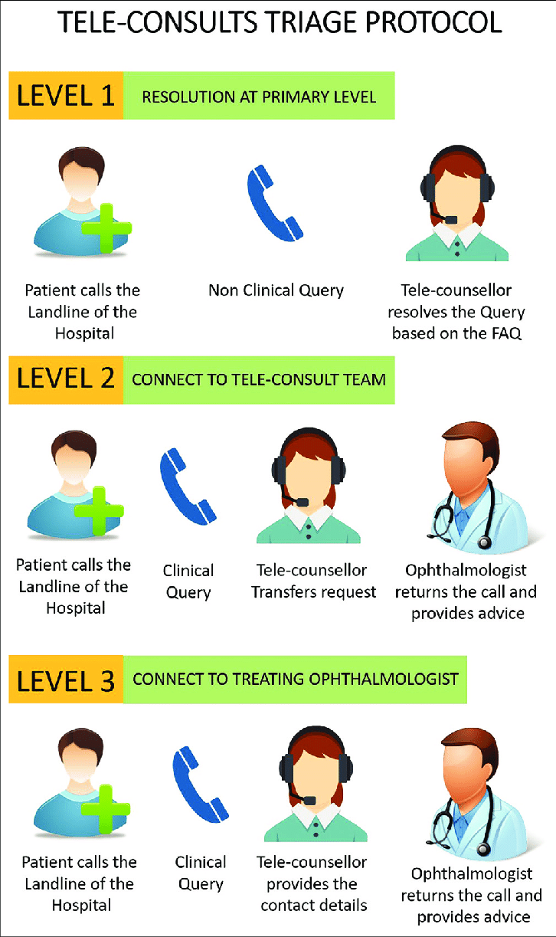
Strategies
Step four : Triage And Risk Assessment

Slide 16
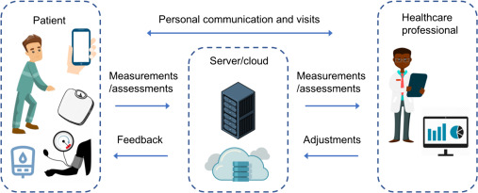
Strategies
Step five: Using artificial intelligence to observe high risk patient in isolated healthcare units

Slide 17
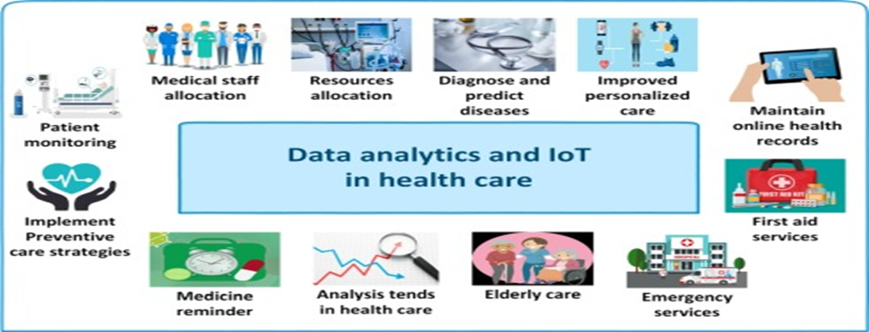
Strategies
Step six: Design an artificial intelligence programs to predict epidemics and track it.

Slide 18
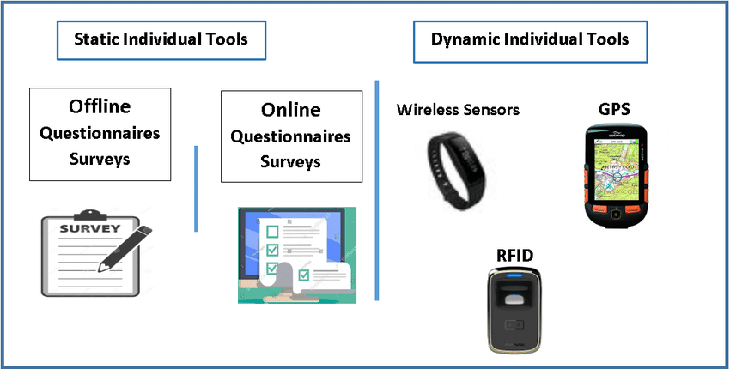
Strategies
Step seven: utilization of application used for Contact Tracing in
Epidemic Discovery

Slide 19
Strategies
Step eight: The biotechnologists design bioinformatics and artificial intelligence tools that enable microbiologists to idintify the offending pathogens

Slide 20
Strategies
Step nine: Using machine learning (ML) and artificial intelligence(AI) for rapid design of new vaccines

Slide 21
Strategies
Step ten : Using the electronic health record, EHR to track the vaccination states of population
Finally E-prescription is fundamental during epidemic

Slide 22
Challenging barriers

Slide 23
Nontechnical challenges
Ethical, legal, and privacy issues
Paucity of high-quality evidence
Health equity
Policy and governance challenges
Resource barriers
Disinformation and misinformation
Technological optimism

Slide 24
Technical challenges
Unreliability of available data
Fragmented, isolated, and unsustainable systems
Leadership and health workforce capacity-building gaps
Infrastructure gaps
Lack of clear standards
Suboptimal design and implementation of digital technologies

Slide 25
References
Iyamu I, Gómez-Ramírez O, Xu AX, et al. Challenges in the development of digital public health interventions and mapped solutions: Findings from a scoping review. DIGITAL HEALTH. 2022;8.
Bringing health care to the patient: an overview of the use of telemedicine in OECD countries, OECD, January 2020.
Dumbrava C., Tracking mobile devices to fight coronavirus, EPRS, European Parliament, April, 2020.
Martin A, Nateqi J, Gruarin S, Munsch N, Abdarahmane I, Knapp B. An artificial intelligence based first-line defence against COVID-19: digitally screening citizens for risks via a chatbot 2020
Ahmad, M., Ahmed, I. & Jeon, G. A sustainable advanced artificial intelligence-based framework for analysis of COVID-19 spread. Environ Dev Sustain (2022

